Slide 1
(Some) Performance Indicators for Centralized Public Procurement
Gian Luigi Albano, Ph.D.
Head of Research
Consip S.p.A. - the National Central Purchasing Body, Italy
Email: gianluigi.albano@consip.it
www.gianluigialbano.com
Istanbul, 28 May 2014

Slide 2
Roadmap
(Some of ) The economic effects of demand aggregation
  Value for money (through different channels)
  Inclusion of SMEs
  Market dynamics
  Transaction costs

Slide 3
(Some) Relevant performance indicators
Economic dimension
Perfomance indicator(s)
Value for money
Savings
Inclusion of SMEs
Degree of success
Market dynamics
Concentration/
entry-exit indexes

Slide 4
Measuring savings
Two main problems :
Reference price(s)
Heterogeneity

Slide 5
The savings estimation methodology by the Italian Institute of Statistics (ISTAT) (1/2)
Step 1. Derive prices of comparable products/services purchased through and outside of Consip frame contracts (FCs)
Comparable prices are derived by using a 3-step procedure:
Public bodies are asked to provide the prices of a given set of products purchased through and/or outside of Consip FCs (p_{consip} and p_{no-consip} respectively);
The monetary value of products features which are specific to purchases made either through or outside of Consip FCs (β_{consip} and β_{no-consip}) is evaluated;
The reported purchasing prices are cleaned of the value of product features which are specific to Consip or non-Consip purchasing contracts, that is:
π_{consip} = p_{consip} – β_{consip} and π_{no-consip} = p_{consip} – β_{no-consip}
π_{consip} & π_{no-consip} are prices of comparable products purchased through and outside of Consip’s FCs respectively

Slide 6
The savings estimation methodology by the Italian Institute of Statistics (ISTAT) (2/2)
Step 2. Estimate the value of realized savings from purchasing through Consip’s FCs
Savings are obtained as the percentage difference between the prices of comparable products purchased under and outside Consip contracts, that is, by computing
1- π_{consip} /π_{no-consip}

Slide 7


The Methodology in a simple picture
Distributing the Survey to collect information on the level and composition of public expenditure on a defined set of products
Results
Non-response bias
Relevance of the results: the higher the non-response rate the lower the informative power of the analysis
Estimation Process
Average prices of comparable products purchased through and outside of Consip’s FCs
Organizing the Dataset to create the variables to be used in the regression estimates
  Regression Estimates to relate purchasing prices to products’ characetristics
Robustness Check
Response rate
Estimated savings
= % Difference between the estimated prices of comparable products purchased through and outside of Consip’s FCs

Slide 8
The 2012 Survey
Distribution of the questionnaire
A sample of 1.216 Central and Local Public bodies were asked to participate in an informative survey which aimed at collecting detailed information on the level and composition of public expenditure with respect to the following set of products, among which: office furnitures, car rentals and car purchases, meal vouchers, fuel, paper reams, gas, photocopiers rentals, PCs, telephone and data networks, servers, lighting services, Microsoft Office software, laser printers, mobile and landline telephone services
Level of participation
The 2012 survey edition was characterized by a satisfying response rate of over 30%
Potential limitations
A low response rate can give rise to sampling bias if the nonresponse is unequal among the participants regarding observed or unobserved characteristics

Slide 9
The estimation process
Organizing the Dataset
The collected data were elaborated and organized in order to:
create homogeneous variables describing products characteristics across different public bodies;
construct clusters of public bodies according to their geographical and institutional characteristics;
create time-dimensional variables on the basis of invoice dates to account for possible price fluctuations of typically seasonal products (e.g., gas);
identify whether or not products/service had been purchased through Consip’s FCs
Regression estimates
The impact of products-specific features on prices was estimated so as to derive purchasing prices of comparable products bought through and outside of Consip FCs;
Robustness check
The preferred specification model is finally selected according to standard goodness of fit indicators

Slide 10
Regression Estimates: Model Specification and Selection
The estimated models take the following form:
where:
p is the purchasing price of each product as reported by the administration;
X_{z} represents the set of each product’s characteristics which are thought to affect its purchasing price, with z=1,…,n;
b_{z} is the monetized value of each product’s characteristics, with ß_{consip} and ß_{no-consip} being the monetary value of product features which are specific to purchases either under and outside Consip’s FCs, respectively;
ε is a residual component, including the influence of unobserved factors on purchasing prices
Prices of comparable products purchased through and outside of Consip’s FCs contracts are obtained as the difference between the purchasing price p and the value of those features which are specific to purchases either through or outside of Consip’s FCs (ß_{consip} and ß_{no-consip} ):
π_{consip} =p_{consip} – ß_{consip}
π_{no-consip} = p_{consip} – ß_{no-consip}

Slide 11
Estimated Savings
Estimated savings from purchasing under Consip contracts are computed as the percentage difference between the prices of comparable products purchased through and outside of Consip’s FCs by type of purchasing body within each geographical area:
 |  | Consip Contract |  | Estimated savings
Type of Administration | Area | YES | NO | DIFFERENCE %
All Local Bodies Central Bodies | North-West (NW) North-East (NE) Center (C) South (S) | π_{consip} | π_{no-consip}

Slide 12

Inclusion of SMEs: The Italian Government’s e-Marketplace (the MePA)
The MePA was launched in 2003:
- to promote electronic purchasing (consistent with EU directive)
- to streamline purchasing processes
- to facilitate SMEs access to low-value procurement market
- since July 1st 2007 compulsory for central bodies (below EU threshold)
Onboarding of the supply side is of paramount importance since it affects:
- the variety of supplies (and thus the level of demand)
- the level of competition in the long run
Identifying the most relevant factors affecting suppliers’ success is above all instrumental to tailor marketing strategies towards the supply side

Slide 13
(Main) Performance indicator for the MePA
Policy relevant question
Explaining the degree of success of micro, small, medium (and large) firms on the Italian public e-marketplace
How effective is e-procurement in opening up public procurement market?

Slide 14
Purchasing tools on the MePA
Public bodies (PBs) can use 2 different purchasing tools:
The Direct Purchase (DP) allows PBs to select goods and services from e-catalogues and buy at the posted price (click-and-buy purchase)
The Request for Quotation (RFQ) allows PBs to select a contractor through an on-line simplified price/quality competition among those firms invited to submit a tender

Slide 15

Descriptive statistics of DPs in the 2005-2010 sample
Distribution of the number and mean value of DPs (€) per firm’s size
Notes:
Attenzione: Qui i valori riportati non sono esattamente identici a quelli delle stat. descrittive delle tabelle precedenti. Questo perché, nel fare questi istogrammi, abbiamo escluso: 1) Le imprese di cui non si conosce la dimensione. 2) I contratti di valore inferiore a € 1 (probabili measurement errors).

Slide 16
The Econometric Model (1/2)
Ordered Logistic Models (OLM) approach:
Appropriate since our dependent variable is a categorical one. The value per each firm’s class:
Micro firms: Y=1
Small firms: Y=2
Medium firms: Y=3
Large Firms: Y=4
Where M stands for the size of the firm (1 = micro, 2 = small, 3 = medium, 4 = large), X is the vector of explanatory variables, and β are the estimated coefficients

Slide 17
The Econometric Model (2/2)
Value of the contract
Variety of the catalogues (posted by suppliers)
Distance effect
Notice Type (ICT and non - ICT)
Nature of the public body (central and local)
Main explanatory variables

Slide 18
Main Findings (1/2)
Higher contract value
Higher variety catalogues
⇒
Higher prob larger firms
ICT notice
Local public authorities
Non-ICT notice
⇒
Higher prob smaller firms
Central public authorities

Slide 19
Main Findings (2/2)
Low contract value
⇒
Higher distance
Higher prob smaller firms
High contract value
⇒
Lower distance
Higher prob larger firms
Moral hazard (driven by anonimity?)
Geography does (seem to) matter!

Slide 20
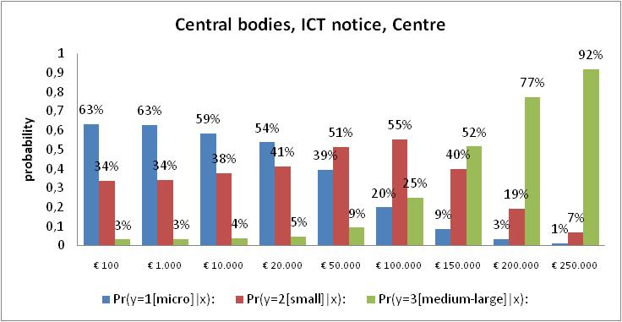
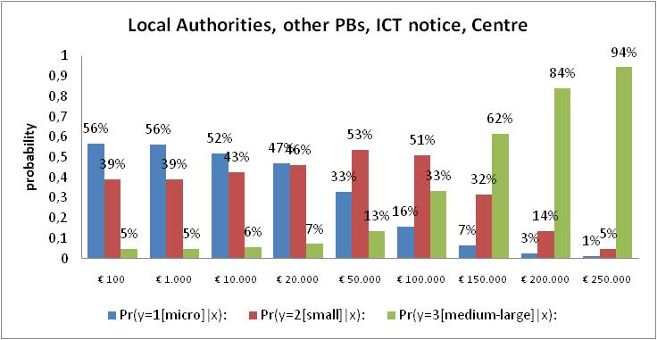
Probabilities of DPs from classes of suppliers for ICT and the Centre

Slide 21
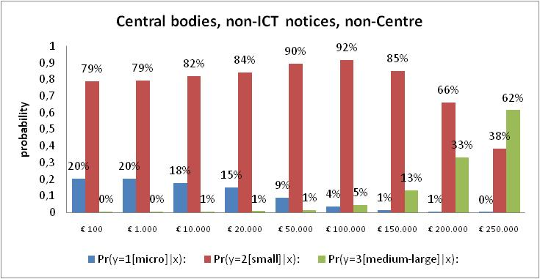
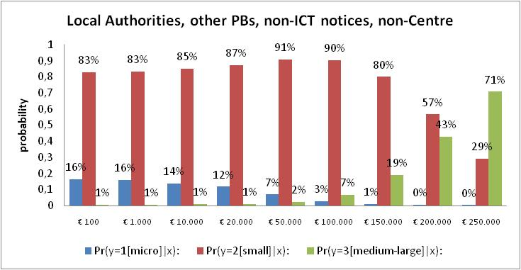
Estimated probabilities for non-ICT notices and all geographical locations but the Centre

Slide 22
Main policy implications
Distance effect
+
Contract value effect
Reputation mechanisms for reducing moral hazard/anonimity
1
2
Onboarding of SMEs requires consideration of several dimensions

Slide 23
Evaluating the impact on a Central Purchasing Body (CPB) on the market
The impact of a CPB’s action on the market structure and dynamic can be analyzed through indicators relying on data based on the CPB’s procurement initiatives only, typically, Framework Contracts or Agreements (FCs or FAs)
Such indicators should be computed and evaluated on the single market/category basis and used:
to compare different markets among each other
to analyze the dynamics of single markets

Slide 24
Some Indicators (1/2)
Participation
N. of bids / N. of lots
N. of bidding firms / N. of lots (takes into account temporary groups of firms)
Concentration
Turnover of the top 3 suppliers in all the editions of the FA / Total turnover of all the editions of the FA
Participation patterns
Entry index: N. “new” firms bidding at time t / N. bidders at time t
Exit index: N. firms bidding at time t-1 but NOT at time t / N. firms bidding at time t-1

Slide 25
Some Indicators (1/2)
Example
45
1
12%
78
2
21%
3
78
21%
4
61
N. Bids per Lot
17%
5
43
12%
6
35
10%
Health Sector
16
Real Estate
7
4%
7
Utilities
8
2%
3
TLC
9
1%
IT
1
10
0,3%
Absolute figures indicate the absolute number of lots
Evaluate the degree of participation in different markets or category groups
Evaluate the degree of concentration of the managed turnover in different markets or category groups

Slide 26
Squeezingmarket
Dynamic market
Exit index vs. Entry index
mean values over (n) editions of each framework contract
Static market
Expanding market
  Entry index: N. “new” firms bidding at time t / N. bidders at time t
  Exit index: N. firms bidding at time t-1 but NOT at time t / N. firms bidding at time t-1

